Slide 1
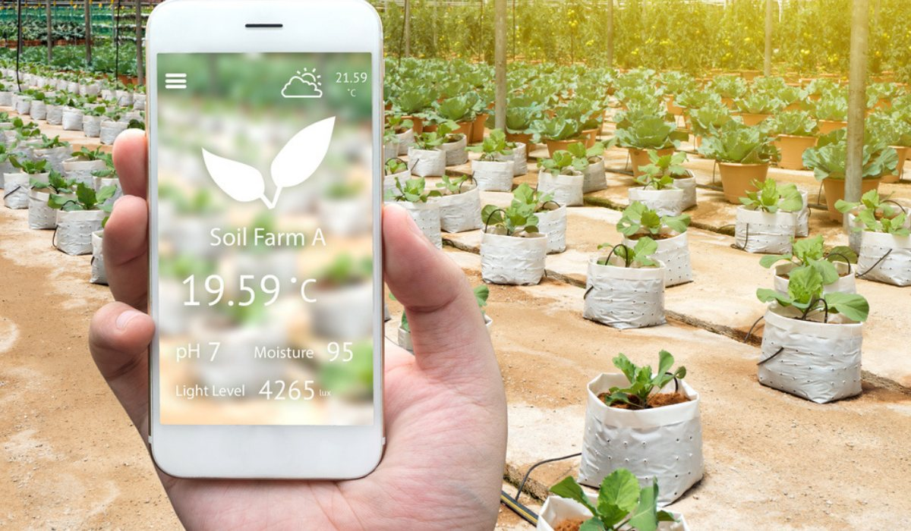
Smart Plant Watering and Matainance System Project
THE GOAL OF THIS PROJECT IS TO GROW PLANTS AND VAGETABLES WITHOUT HUMAN INTERACTION OR WITH MINIMUM INTRACTION
OBJECTIVES
TIMEBASED AUTOMATED WATERING OF PLANTS
TEMPERATURE AND SOIL MOISTER MONITERING AND ALERT SYSTEM WHEN TIGGERED OUT OF GIVEN DATA RANGE
TIMEBASED AUTOMATED PLANT FULL SPECTRUM LIGHT
TIMEBASED FERTILIZER[LIQUID NPK] APPLY TO SOIL

Slide 2
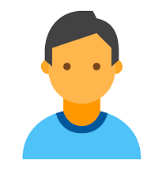
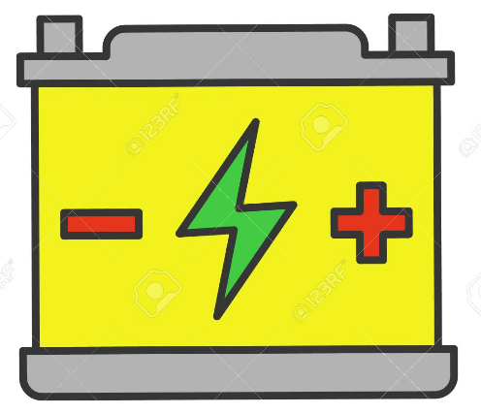
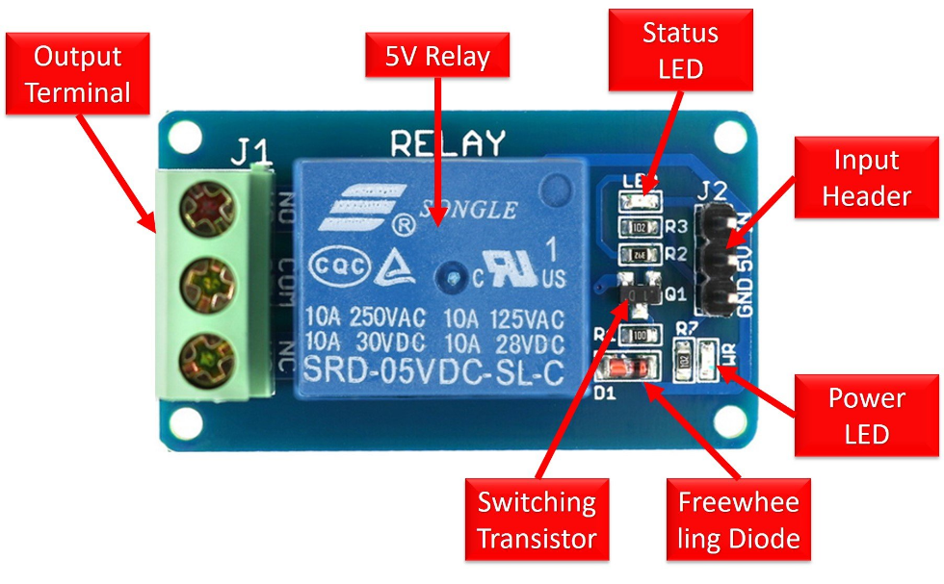

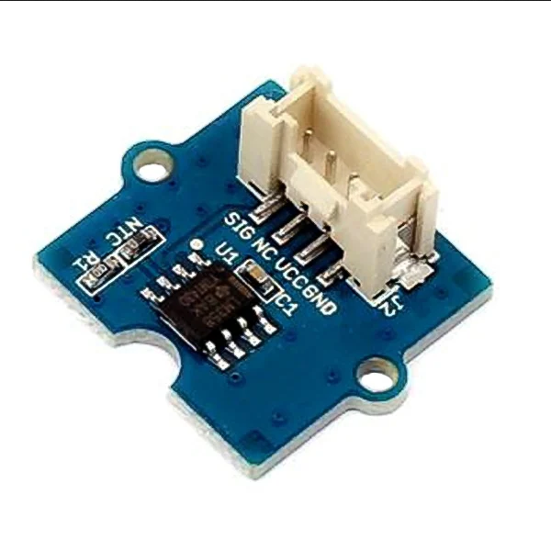
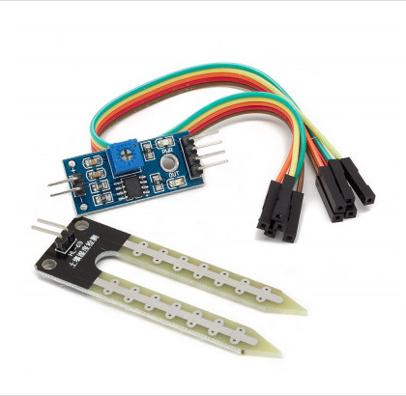

BLOCK DIAGRAM
PLANT WATERING PUMP
NodeMCU MicroController
RELAY CONTROLLED BY NODEMCU
**********Digital Pins***********
**********Analop Pins ***********
ESP Wifi Module
TEMP DATA OF SOIL
TEMPARATURE SENSOR
ALL SENSOR DATA RECIEVED SENT TO CLOUD SERVER DATABASE
MOISTER DATA OF SOIL
Soil Moister Sensor
Soil Moister Sensor
Power Supply 5v

Slide 3
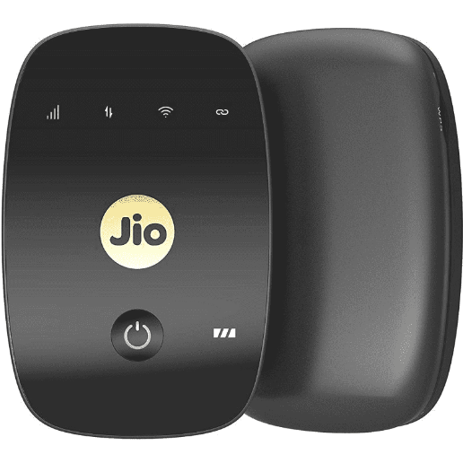
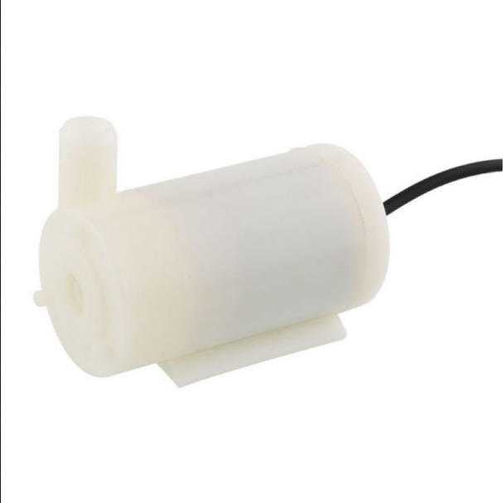
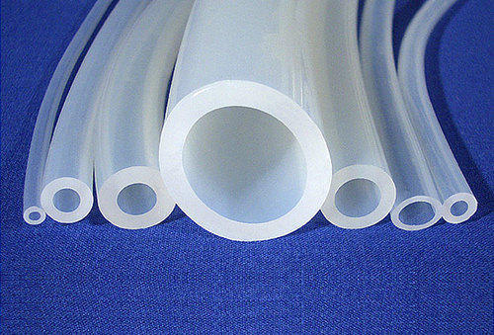
COMPONENTS
NodeMCU MicroController
TEMPARATURE SENSOR
Soil Moister Sensor
**********Digital Pins***********
**********Analop Pins ***********
ESP Wifi Module
4G ROUTER
5V-12V SUBMERSIBLE PUMP
5V RELAY
Power Supply 5v
SILICON TUBING

Slide 4


AUTOMATE PLANT WATERING BASED ON SOIL MOISTER DATA

